Slide 1
Linux Kernel Modification for Security and Lightweight Operating System
TEAM MEMBERS :
PARVESH PRABHU V
PRASSANNA S
THIVIYAN M
PAVENTHAN T
GUIDE :
S.S.ASHWIN KUMAR, AP/IT
D.SUGANTHI, AP/IT

Slide 2
PROBLEM STATEMENT :
The default Linux kernel is designed for general-purpose systems, leading to
Increased kernel size
Unused subsystems
Higher memory usage
Security vulnerabilities
making it inefficient for lightweight and security-sensitive environments.

Slide 3
OBJECTIVES :
To reduce the Linux kernel size by removing unused components
To optimize memory management for better stability
To enhance network security at the kernel level
To implement kernel-level security mechanisms
To improve overall system performance and security

Slide 4
EXISTING SYSTEM :
DISADVANTAGE :
Uses a general-purpose Linux kernel
Includes support for multiple hardware architectures
Default memory management and OOM handling
Network security mostly handled in user space
Optional and complex security frameworks
Large kernel size
Higher memory and CPU usage
Increased attack surface
Slower boot time
Security mechanisms are optional and complex

Slide 5
PROPOSED SYSTEM :
ADVANTAGE :
The proposed system uses a customized Linux kernel with targeted modifications to improve performance and security.
The kernel is optimized by removing unnecessary components, modifying memory and network modules, and implementing a kernel-level security module to enforce mandatory access control.
Reduced kernel size and faster boot time
Lower memory and CPU usage
Improved system stability
Enhanced kernel-level security
Reduced attack surface

Slide 6
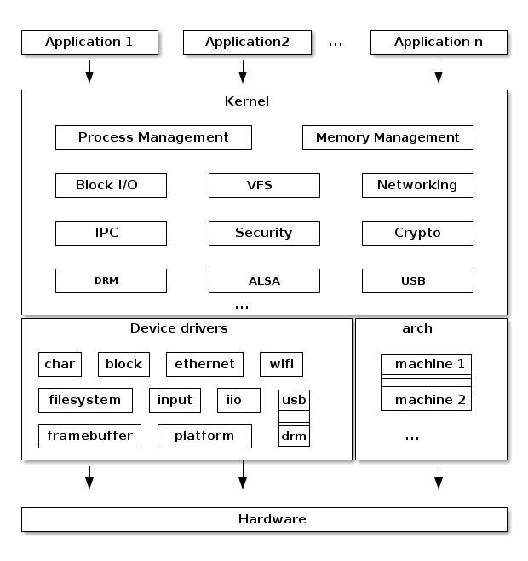
SYSTEM ARCHITECTURE :

Slide 7
MODULES :
Module – 1 : Kernel Lightening
Module – 2 : Memory Module Modification
Module – 3 : Network Module Modification
Module – 4 : Security Module Modification

Slide 8
MODULE 1 – KERNEL LIGHTENING :
EXPLANATION :
Kernel lightening is achieved through compile-time configuration pruning by disabling unused drivers, debugging, and tracing features.
Modularization and timer optimization are also applied to reduce kernel size, memory usage, and improve boot time.
Algorithm used -> SCPA(Static Configuration Pruning Algorithm) : It analysis required system features, disable unused kernel components at compile time and produce a minimal kernel build.

Slide 9
WORKING PROCESS :
• The required system features are analyzed to identify necessary kernel components.
• Unused drivers, filesystems, debugging, and tracing features are disabled during kernel configuration.
• Kernel is compiled with only essential modules using configuration tools.
• The optimized kernel is built and deployed to reduce size and improve performance.

Slide 10
ADVANTAGES :
• Reduced kernel size and faster boot time.
• Lower memory and CPU usage.
• Improved system performance and efficiency.
• Reduced attack surface leading to better security.

Slide 11
MODULE 2 – MEMORY MODULE MODIFICATION :
EXPLANATION :
• Memory module modification focuses on optimizing the Linux kernel’s memory management mechanisms to improve efficiency and system stability.
• The kernel memory allocators and page management techniques are analyzed to reduce unnecessary memory usage, fragmentation, and overhead during runtime.
• Memory reclaim strategies are tuned to efficiently free unused pages and minimize excessive swapping, thereby improving system responsiveness under load.
• Algorithm used → MMOA (Memory Management Optimization Algorithm) :
It monitors memory allocation patterns, optimizes allocator behavior, improves page reclamation, and ensures efficient utilization of available physical memory.

Slide 12
WORKING PROCESS :
• The kernel monitors memory allocation requests generated by running processes.
• Memory pages are allocated using optimized kernel allocators such as buddy and slab allocators.
• Unused or inactive memory pages are reclaimed to free memory for active processes.
• Cache usage and memory fragmentation are minimized to maintain efficient memory distribution.

Slide 13
ADVANTAGES :
• Improved memory utilization and reduced memory overhead.
• Faster memory allocation and better system responsiveness.
• Reduced memory fragmentation and improved kernel stability.
• Better overall system performance under high workload conditions.

Slide 14
MODULE 3 – NETWORK MODULE MODIFICATION :
EXPLANATION :
• Network module modification aims to enhance kernel-level network security and performance by controlling packet flow within the Linux network stack.
• Incoming and outgoing packets are inspected at the kernel level before reaching user-space applications to ensure early filtering and control.
• Rule-based packet filtering is applied to identify and block unwanted or malicious traffic, reducing network overhead and improving security.
• Algorithm used → RBPF (Rule-Based Packet Filtering Algorithm) :
It analyzes packet attributes such as IP address, port number, and protocol type, compares them against predefined rules, and decides whether to allow, drop, or log packets.

Slide 15
WORKING PROCESS :
• Network packets are received from the network interface card (NIC).
• The Linux kernel network stack processes packet headers and extracts relevant information.
• Packet filtering rules are applied to evaluate the packet properties.
• Based on rule evaluation, packets are allowed, dropped, or logged for monitoring purposes.

Slide 16
ADVANTAGES :
• Improved network security through early packet filtering.
• Reduced unwanted network traffic and system overhead.
• Faster packet processing at the kernel level.
• Increased protection against network-based attacks.

Slide 17
MODULE 4 – SECURITY MODULE MODIFICATION
EXPLANATION :
Security module modification focuses on enhancing the Linux kernel’s ability to enforce access control and protect system resources.
The module introduces kernel-level security mechanisms to monitor and control process behavior and resource access.
Mandatory Access Control (MAC) principles are applied to restrict unauthorized operations within the system.
Algorithm used → ACM (Access Control Mechanism) :
It evaluates process permissions, validates access requests, and enforces security policies to allow or deny operations.

Slide 18
WORKING PROCESS :
System calls and process activities are monitored at the kernal level.
Security checks are performed whenever a process tries to access files, memory, or network resources.
Access control rules are applied based on predefined security policies.
Unauthorized actions are blocked, and suspicious activities can be logged for analysis.

Slide 19
ADVANTAGES :
Enhanced system security through kernel-level protection.
Reduced risk of unauthorized access and privilege escalation.
Improved control over process and resource usage.
Strengthened defense against system-level attacks.

Slide 20
CONCLUSION :
This project demonstrates that targeted Linux kernel modifications can significantly reduce kernel size while improving performance and security. The customized kernel provides better resource utilization, reduced attack surface, and enhanced stability, making it suitable for lightweight and security-critical environments.

